Slide 1

Teradata UDA解决方案介绍
Yao Ran Senior Solution Architect
Feb 2017
Notes:
Alternate title slide – move to beginning of deck, or delete if not used.

Slide 2

目录
权威机构如是说
Teradata UDA解决方案介绍
Teradata UDA客户实施案例
UDA Demo
2

Slide 3
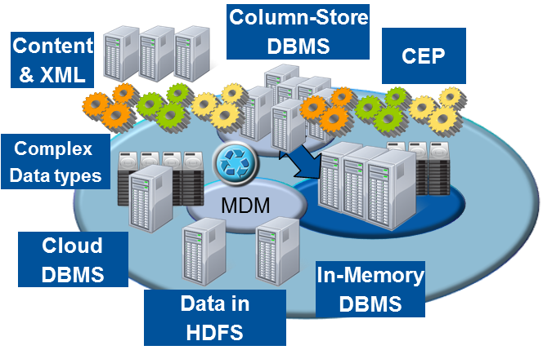
Shift from a Single Platform to an Ecosystem
"Logical" Data Warehouse
“We will abandon the old models based on the desire to implement for high-value analytic applications.”
Notes:
Gartner recognizes the requirement to use multiple diverse systems to provide a complete analytical environment also. They talk about the Logical Data Warehouse including many types of systems and technologies to provide a comprehensive analytical environment for an enterprise.
***************
Industry research shows the shift from a single system to an ecosystem where different technologies can unify and process data in the most efficient and specialized way to add the most value
Gartner calls this movement the “logical data warehouse” which is being driven by a “desire for high-value analytics”
EMA and 9sight research shows that, on average, most companies tackle big data with 3 systems including “analytic databases, discovery platforms, and NoSQL solutions” (more details below)
===============
When asked how many nodes (nodes refers to a separate system/DB in their architecture) were part of their Big Data initiatives, the EMA/9sight survey respondents indicated that a wide number of Hybrid Data Ecosystem nodes were part of their plans.
The most common answer among the 255 respondents was a total of Three Hybrid Data Ecosystem nodes as part of the respondents’ Big Data Initiatives, showing that Big Data strategies are not limited to a single platform or solution. When the Two to Five Hybrid Data Ecosystem nodes indications are aggregated, over two thirds of respondents are included in this segment. This shows Big Data Initiatives are focused on more than just a single platform (e.g. Hadoop) augmentation of the core of operational platforms or the enterprise data warehouse. Rather, Big Data requirements are solved by a range of platforms including analytical databases, discovery platforms and NoSQL solutions beyond Hadoop.

Slide 4
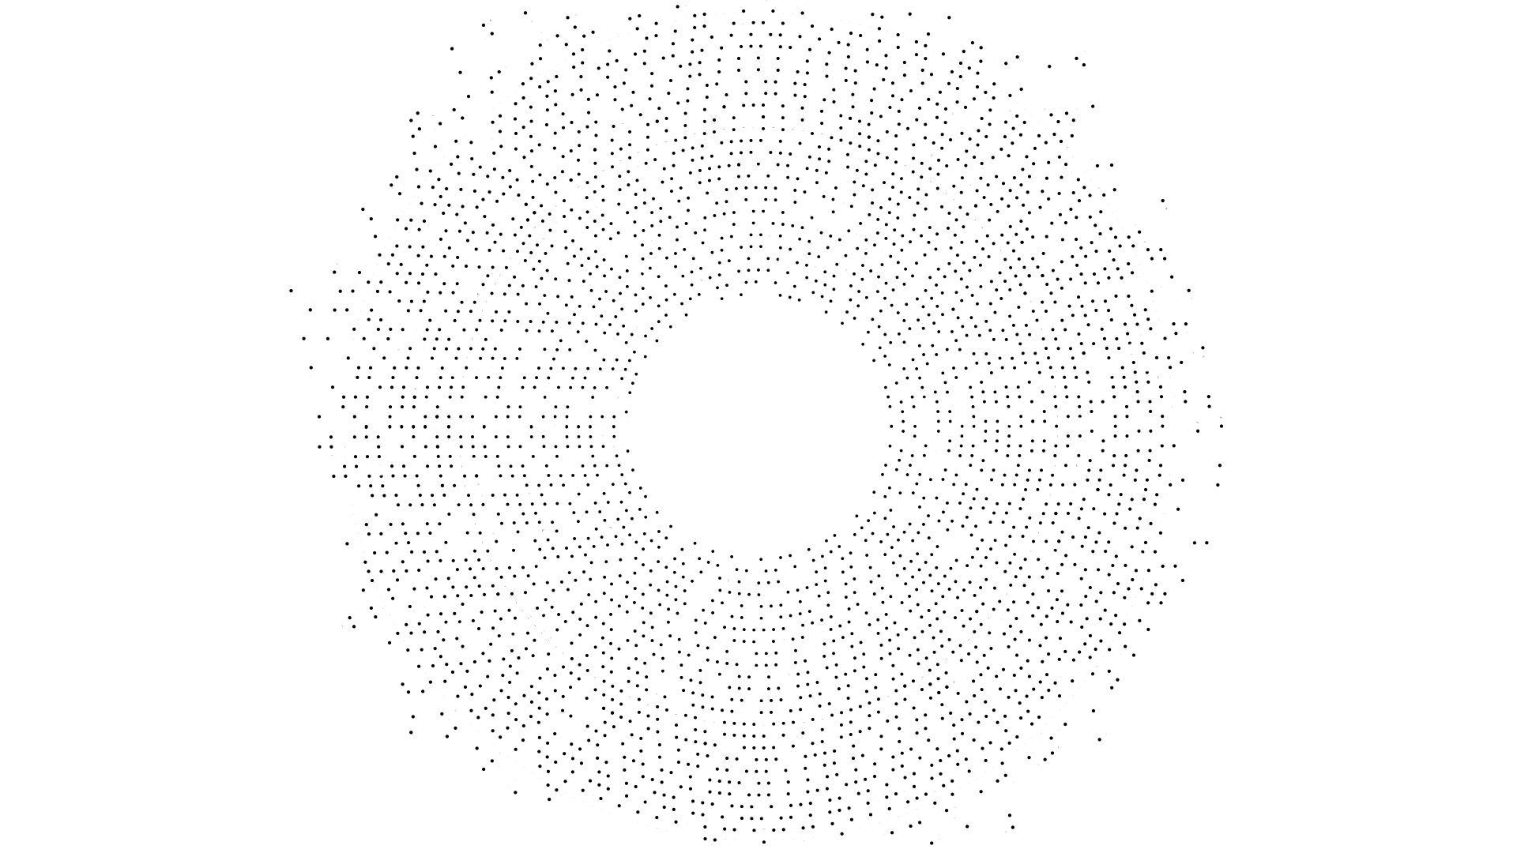

Data Distribution in an Ecosystem – Siloed by Domain
FINANCE
OPERATIONS
Telemetry
ELECTRONIC COMMERCE
RFID
SERVER LOGS
Maps
Orders
Revenue
Expenses
Inventory
Returns Manufacturing Supply Chain Customer Service
IVR Routing
SENSOR
SOCIAL MEDIA
2855
Case History
CUSTOMER EXPERIENCE
CUSTOMER CARE – AUDIO RECORDINGS
Customers
Campaign History
Customers
Products
Pipeline
EXTERNAL INTERACTIONS
DIGITAL ADVERTISING
CUSTOMER PORTAL INTERACTIONS
CLICKSTREAM INTERACTIONS
MARKETING
RATINGS & REVIEWS
SALES
Accurate analytics require integration of data across your ecosystem
© 2015 Teradata

Slide 5
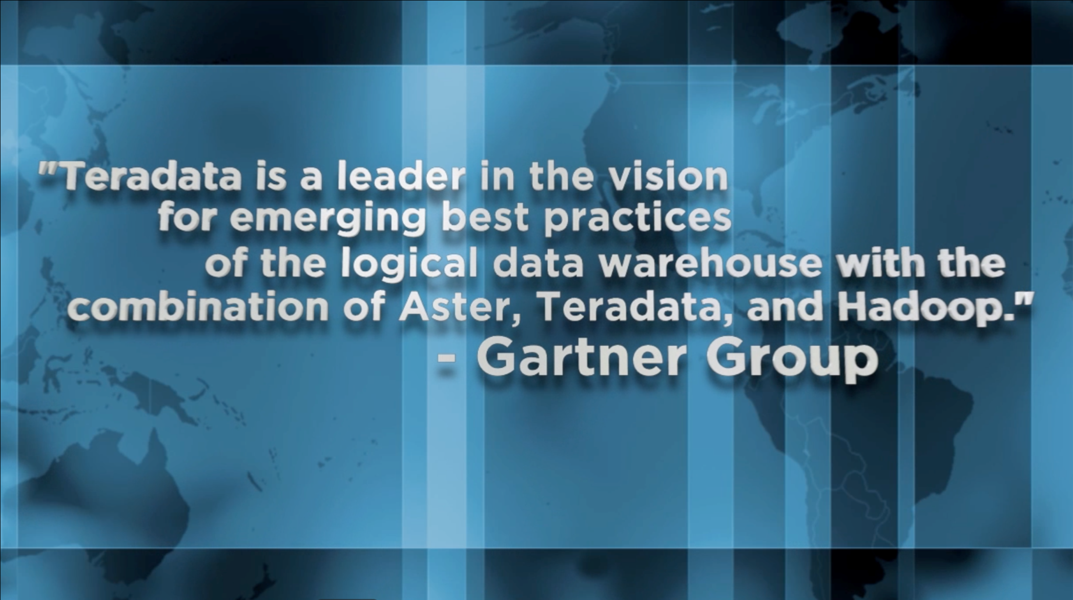
Notes:
We strongly believe that our vision is right and we have a great opportunity to lead the market with our Unified Data Architecture and again competitive advantage.
Gartner acknowledges that Teradata is a leader in implementing this architecture, but we’re not stopping here.
We’re introducing our Teradata QueryGrid with Teradata 15 to take our Unified Data Architecture to the next level with more integration and optimization between the various compute engines in the UDA.

Slide 6
Teradata UDA解决方案介绍

Slide 7
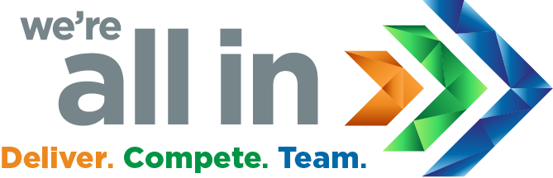
Sources
Acquisition
Data Engines
Analytics
Access
Users
REAL TIME
Audio and Video
Marketing Executives
NO SQL
MULTI GENRE
DATA LAKE
DATA LAKE
APP FRAMEWORK
Sensors
Operational Systems
VIRTUAL QUERY
OPERATIONAL
Text
INGEST
Customers Partners
EMERGING
Web and Social
IN MEMORY
Knowledge Workers
DATA WAREHOUSE
Business Intelligence
DATA WAREHOUSE
Machine Logs
COMPUTE CLUSTER
CONVENTIONAL
Languages
Business Analysts
crm
Integrated
Development
Environment
Data Scientists
scm
Platform Services
DATA
DEVELOPMENT
OPERATIONS
erp
Cloud Deployment
PUBLIC
PRIVATE
HYBRID
Engineers
© 2017 Teradata

Slide 8
Sources
Ingest
Prepare
Consume
Users
GOVERNANCE & SECURITY
Audio and Video
Data Storage Types
Analytic Techniques
Marketing Executives
RELATIONAL DATABASE
QUERIES, REPORTS, DASHBOARDS
VISUALIZATION FUNCTIONS
Sensors
Operational Systems
DISTRIBUTED FILE SYSTEM
KEY VALUE STORE
Text
PATH & PATTERN
GRAPH
Customers Partners
Web and Social
STATISTICS & MACHINE LEARNING
Knowledge Workers
DOCUMENT ORIENTED
GRAPH DATABASE
TIME SERIES
Machine Logs
Business Analysts
WIDE COLUMN STORE
CONTENT ANALYTICS, SENTIMENT EXTRACTION
crm
Data Scientists
scm
erp
Metadata
Engineers
OPERATIONAL
</>
TECHNICAL
BUSINESS
© 2017 Teradata

Slide 9








UDA之核心技术-Teradata QueryGrid™
Entry Points
TERADATA Database
Aster Analytics
Presto Hadoop
Targets
TERADATA Database
Aster Analytics
Presto Hadoop
Hive / HDFS
Hadoop
Other Databases
NOSQL
DATABASES
Integrated Data Warehouses
Multi-Genre Advanced Analytics™
Multiple Hadoop SQL Query Engines and Distributions
3rd Party Relational DBs
Non-Relational DBs
Presto
Connectors
Teradata Certified
Community Supported
MySQL
Postgresql
Amazon S3
APACHE CASSANDRA
APACHE KAFKA
PRESTO API

Slide 10
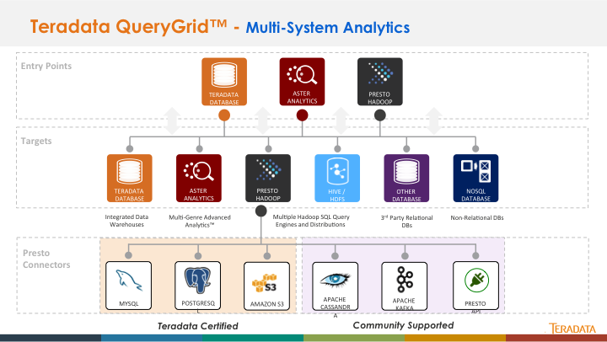
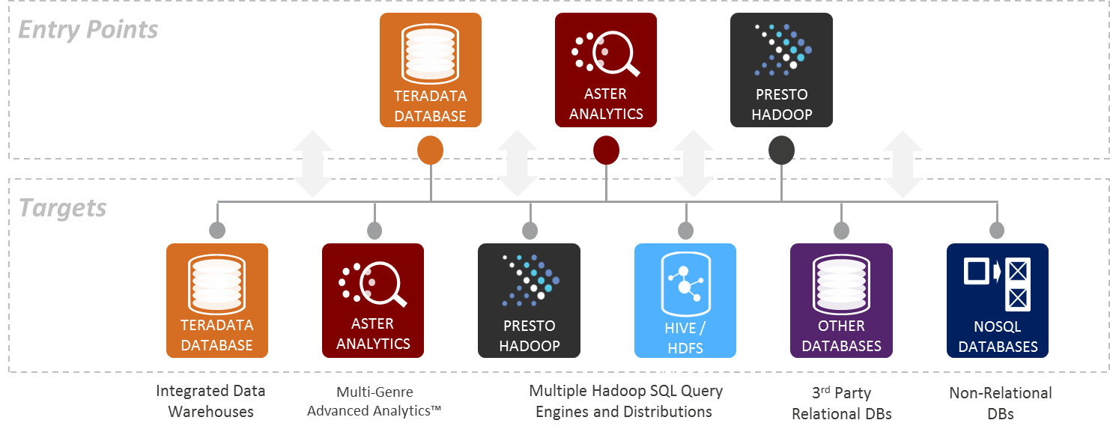
Data Fabric Enabled by QueryGrid™ Analytic Flexibility to meet your business needs
Users direct their queries to a cohesive data fabric using existing SQL skills & tools
Pick Your Best-of Breed Technology:
Data types
Analytic engines
Economic options
Run the right analytic on the right platform:
Minimize data movement, process data where it resides
Minimize data duplication
Optimized work distribution through “push-down” processing
Bi-directional data movement
Focus on data and business questions, not integrating separate systems
Notes:
We like to call this seamless multi-system environment the ‘Data Fabric’
Customers get the analytic flexibility to meet their business needs by picking the best of breed technologies that fit their needs
Different systems have different strengths and uses at different price points, so there are many considerations that businesses take into account such as
Workload and data characteristics, CPU / I/O usage, availability and service level agreements as well as economic constraints
Run the right analytic on the right platform
Take advantage of specialized processing engines while operating as a cohesive analytic environment
Using a consistent interface using SQL so that you can leverage your existing tools and skillsets
QueryGrid allows them to focus on data and business questions and not the difficulty of integrating the separate systems

Slide 11
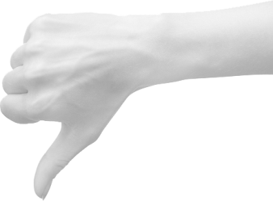

QueryGrid是什么和不是什么
DTG
QueryGrid不是什么:
A substitute for integrating data in the warehouse
A general purpose data virtualization platform
An automatic cross system optimizer
A performance enhancement for remote systems
QueryGrid是什么:
Seamless, high-performing data access, processing and movement
High Performance multi-system analytics
Easy self service SQL interface
Parallel bi-directional data movement

Slide 12
QueryGrid 2.0功能特性
Higher Performing, Higher Concurrency architecture
All enabled query engines can initiate data access
Universal feature set provided by all connectors
Includes an expanded feature set
Transport
Socket Pools
Wire Protocol
Compression *
Throttling *
Routing
Network Selection
Skew avoidance
Bridge support *
Redistribution *
Security
Authentication
Encryption
Administration
Centralized Configuration
Automated Installs
Zero-down time Upgrades
DevOps
Monitoring
Health Checks
Performance Monitoring
Alerting
Troubleshooting
Centralized Logging
Diagnostic Checks
*Future

Slide 13
Teradata UDA客户案例

Slide 14
QueryGrid应用场景案例
行业客户 | 场景 | 成熟度
车辆制造 | 维护目标识别 | 日常应用
 | 识别过度保养 | 原型
通讯 | 提高客户保有量 | 日常应用
金融服务 | 监控经纪业务合规 | 生产上线
 | 网页日志序列化 | 原型
旅游 | 网络日志渠道用户转化 | 日常应用
 | IVR呼叫中心日志用户转化 | 原型
 | 提升网页设计及A/B测试 | 日常应用
计算机制造 | 从客户浏览日志识别潜在客户 | 日常应用
电信运营商 | 减少客户流失 | 日常应用
 | 呼叫中心仪表盘之客户满意度 | 原型
电子商务 | 提升站内检索 | 生产上线
金融系统服务商 | 降低差旅费用支出 | 生产上线
电子元器件制造 | 监控过程质量 | 原型
Notes:
Production means the use case is in full production, typically automated with batch job scheduling and usage by the business or engineering community
Daily use means that the users invoke QueryGrid when they need it which may be several times a day but not necessarily everyday. This is especially common with data science exploratory analysis.
Prototype means the customer was working on this project when they were being interviewed. This workload may or may not go into production or daily use. Its shown to give an indication of interest by the user community.
Note that the term “production” is ambiguous in a discovery environment. In some situations, a discovery or exploratory environment is used as needed or on demand. This is in contrast to passing through a quality assurance process and the workload being handed off to the data center operations staff to run in batch or similar modes. Discovery environments by their nature are often self service interactive workloads.

Slide 15

车辆制造商
INTEGRATED DATA WAREHOUSE
目标
利用传感器数据实现预测性维修
业务人员与工程师协作脱节
挑战
从传感器数据中获取更多的价值
业务用户如何使用SQL工具去获取数据并分析？
回报
QueryGrid为业务用户与工程师构建了一座沟通的桥梁！
业务分析师
Teradata
Database
Query Grid
DATA PLATFORM
工程师 &
程序员
Hadoop
Notes:
The company manufactures and operates large complex vehicular equipment with critical life and safety issues. The equipment is highly computerized with sensors monitoring every aspect of its operation. Sensor readings stream back to the company in batches throughout the day.
A typical vehicle generates a few megabytes per day with several thousand data items, which is stored and maintained for about $1,000 per year. The sensor data is stored in HDFS cluster, which enables low-cost access to the entire sensor history. The problem was “getting answers from the sensor data in a timely fashion” to improve the operation of that equipment.
The first use case was the daily maintenance of the equipment. By monitoring whether the sensor readings were within specified limits, the company could identify specific components for repair or replacement. However, the company realized that the potential was far greater, spanning many functions, such as failure predictions, accident investigations, long-term maintenance strategies, design testing, and operational efficiency. This was no longer a single-purpose application, but the beginning of an evolving infrastructure with impacts across their business. Hadoop people were happy doing their MapReduce stuff while the IT people were happy doing SQL.
Although the Hadoop platform supported a variety of processing using Pig, Hive, and MapReduce, specialized skills required and complexity of coding limited the number of users accessing this platform. Further, the analyses required blending other reference data (such as equipment schedules, staffing) that was constantly changing and maintained on the Teradata data warehouse system.
The corporate IT staff and Hadoop developers needed to apply their distinct capabilities and collaborate to solve the larger issues of sensor analysis. These were two cultures with different skill sets, project timelines, management reporting lines, and degrees of urgency. The Hadoop people were “happy doing their MapReduce stuff” while the IT people “were happy doing SQL”. But some type of bridge was required between the infrastructures and the two cultures. One solution would be to extract sensor data from HDFS and load it into the data warehouse. However, the data volumes and query diversity made this approach cumbersome.
About this time, Teradata released system-to-system connector called SQL-H, which provided a bridge between the two cultures and resulted in a “more natural” work environment. Moreover, this bridge provided the basis for collaboration. If the SQL queries produced datasets that were too large, data on Hadoop is reorganized to be more selective during a QueryGrid request.
The SQL OVERLAP and INTERSECT temporal extensions on the Teradata platform enabled a simple way to dissect complex time overlapping of sensor data, which is otherwise error prone. In addition, temporal compression achieved dramatic efficiency improvements, opening up new analysis opportunities for the company.
The second use case is detecting unnecessary maintenance. The company found a high percentage of “false positives,” which caused vehicles to be serviced unnecessarily, thus increasing operational costs. The company is now better with their sensor analysis, reducing unnecessary maintenance costs.

Slide 16

金融服务
业务分析人员
INTEGRATED DATA WAREHOUSE
Discovery platform
目标
经纪人夸大了投资回报
政府审计与资金处罚
挑战
针对Outlook邮件内容文本分析
调查可能存在的违规
序列化会话
回报
排除了50%的假性案件
极大地降低阅读邮件的人工
Teradata
Database
Aster
Database
Query Grid
DATA PLATFORM
业务分析人员
Hadoop
Notes:
The company provides consumer and commercial financial services. Over the years, the company’s IT infrastructure has grown to over a petabyte of data managed among the Teradata, Aster, and Hadoop platforms. It’s a sales brokerage compliance application in a heavily regulated industry. Any communications to customers -- in this case email -- has to be audited to be sure that the brokers are not over promising financial results to clients. There are over 2500 rules regarding statements that suggest improper behavior. Previously it was an all manual process with a lot of false positives. It took 50 people on shore, 250 offshore scanning emails, manually. Furthermore, the company has to set aside up to $50M in reserves in case a lawsuit occurs. And failure to provide thoroughly audited proof of broker behavior can cause the government and Securities Exchange Commission to levy steep fines in the millions of dollars.
The Aster team took their rules and had an offshore contractor write them in Perl. The team also created an Outlook.PST map-reduce function to parse emails.
What makes this challenging is the back and forth communications between people such that one email thread gets longer and longer. One thing we did was reduce the extensive text (signature lines, repetitive text). The customer dumped all broker email into Hadoop. They cleaned up the emails using Hadoop. They then use Aster SQLH to run the filtering algorithm pulling the data set from Hadoop where the remaining rules are applied. This reduced false positives 50%.
The daily volume is 2.3M email messages a day. 50TB per year.
When the bank use requests information, Aster uses SQLH to pull data from Hadoop. Aster refines the data and uses QueryGrid to send the data to the Teradata Data Warehouse. The data warehouse displays the final dashboard is displayed. Some of this involves batch scripts.

Slide 17

电子商务
业务分析师
INTEGRATED DATA WAREHOUSE
Discovery platform
目标
提升客户站内搜索体验
挑战
使用Hadoop平台实现文本挖掘，并返回到EDW
回报
使业务分析师可以使用他们熟悉的工具访问数据（如BI工具、数据库客户端查询工具等）
Query Grid
Teradata
Database
Aster
Database
Query Grid
DATA PLATFORM
网络客户
Hadoop
Notes:
The eCommerce company focuses on improving the effectiveness of online customers to find and purchase products matching their needs. The Teradata database system supports their enterprise data warehouse (EDW), which encompassed most of their business functions, while a separate appliance-based Hadoop platform supports behavioral analytics.
The company was an early adopter of the Hadoop platform, which was initially for “skunkworks projects focused on unique hard problems that were considered unsolvable through existing technology solutions.” Over a few years, the company gained confidence in the Hadoop platform and blended it with their mainstream IT infrastructure.
The early applications that used the Hadoop platform often required most of its data from the EDW. Hence, an early requirement was to move data in both directions between Hadoop and Teradata platforms. This is different from typical Hadoop adopters who compile massive datasets from website click-streams and generate small result sets to be transferred to their EDW.
One application took text data from the EDW, performed text mining on Hadoop, and returned results to an external search provider. Later, other applications transformed data and moved results back to Teradata. The motivation for these was mainly for cost savings by reducing the Teradata workload. The policy was “high value jobs on high cost systems,” implying analytical use cases had higher value than data preparation use cases. More recently, there is blending of the platforms so that “users are allowed to do the things they are best at” on their preferred platform.

Slide 18
UDA Demo环境演示
Notes:
Alternate divider slide

Slide 19

我们坚信…
分析和数据将会释放伟大企业的无穷潜力
Notes:
We believe that analytics and data unleash the potential of great companies.
Analytics and data have become the number one assets in organizations that are driving differentiated value. When companies treat analytics and data as their number one asset, they have the now have the ability to transform organizations.
Whether your company is working to:
Reduce the time for clinical trial for new drugs;
Improve yield for farmers by better managing soil and crops
Lower carbon emissions; or
Improve communications between people
… there is unlimited potential to what data and analytics can unleash.

Slide 20
Notes:
Closing slide for all presentations

